Slide 1

Ramsey El Lethy
Everything
R and Rstudio
The Scholarly Reading Circle for Economics

Slide 2

01
INTRODUCTION
OVERVIEW
02
Setup
03
Presentation/Live Demo

Slide 3

How to get involved!
(In department) Econometrics/CS+Econ Courses
(Out of Department) BSIS + DS
Illinois Data Science Club
STAT/CS/IS 107 “Data Science Discovery”
UIUC Datathon
UIUC Anyware (STATA)
Econ Data Lab (see me or Noel for info)

Slide 4


INTRODUCTION
01

Slide 5


Slide 6

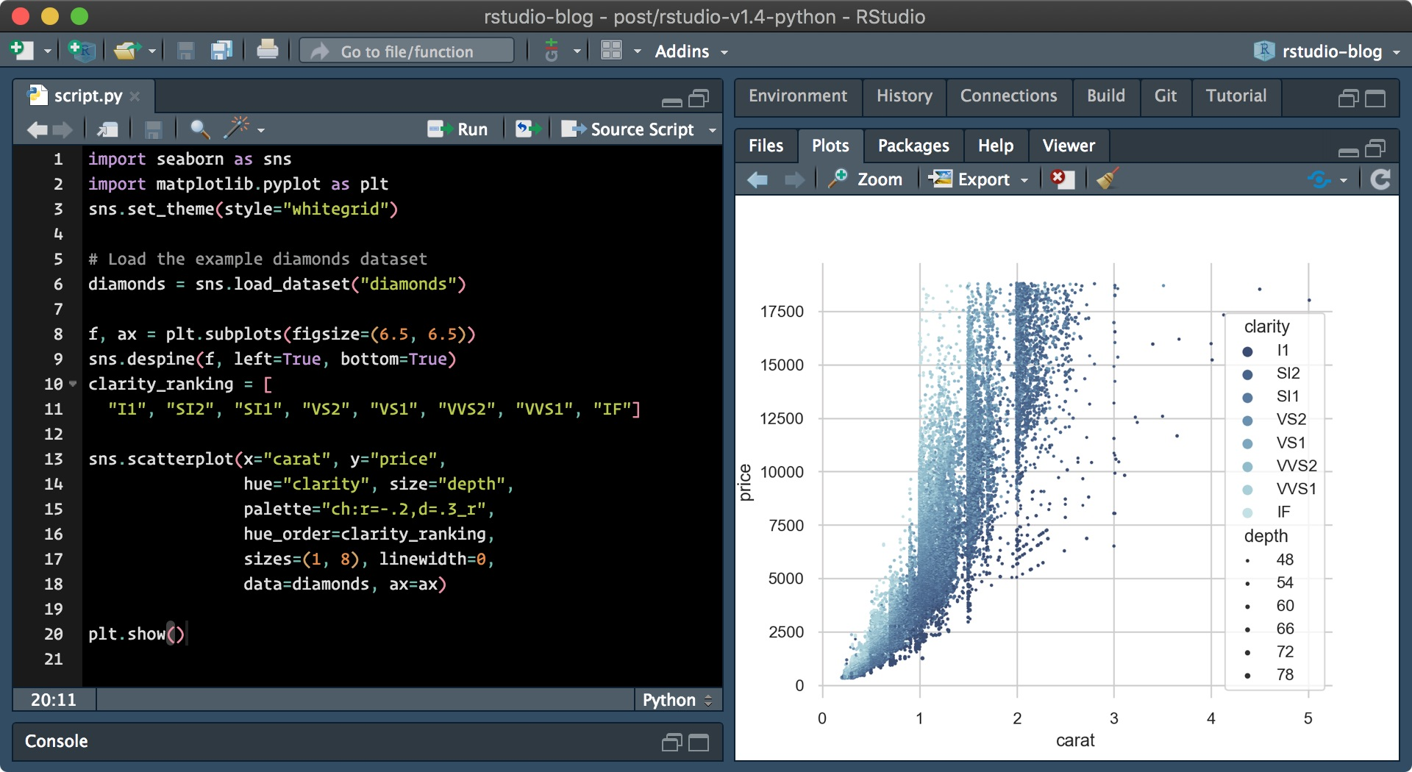
What is R?
R, or the R project for statistical computing, Is a language and environment designed for statistical computing and graphics
Why R?
R does a really good job at being simple yet effective
The designers have taken great care in emphasizing user control and decision making
Its Free!
R as language

Slide 7

“
R is the world's largest most powerful programming language for statistical computing machine learning and graphics, and has a thriving global community of users, developers and contributors.
MRAN
(Microsoft R Open)

Slide 8
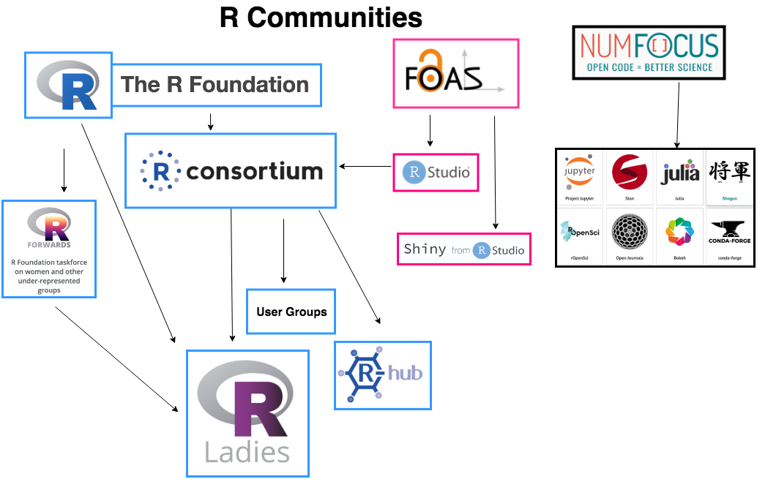


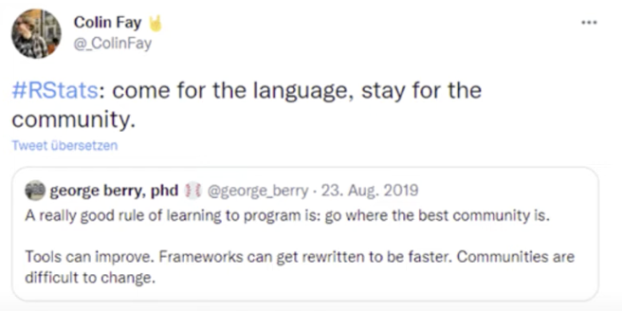
Community!

Slide 9

Setup
02

Slide 10
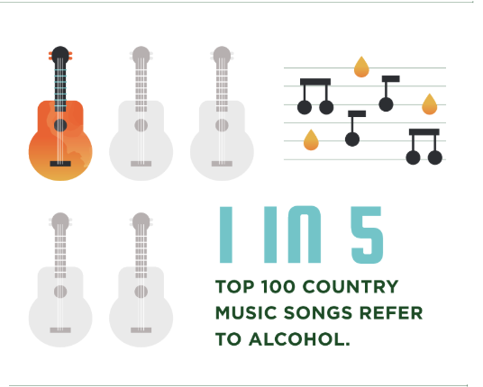

Slide 11

Download R/Rstudio Environment
Download Dataset from GitHub, specify folder, set working directory
Get to coding!

Slide 12

Live Demo
03

Slide 13

Supervised vs. Unsupervised Learning
Terms:
Outcome (Y) AKA Dependant Variable, Response, Target Variable
A vector or list of predictors (p) called (X) AKA inputs, regressors, covariates, features, independent variables
Training Data (x1, y1) , ….. , (xn, yn). Observations (Examples, Instances) of the above measurements

Slide 14
Supervised Learning
So, now that we understand what terminology we are using, we can describe our goal, what are we trying to do with these?
Well, We can use the training data to
Accurately predict unsee test data (so predict what the next instance of data could be)
Understand/infer which inputs affect the outcome and how
Assess the quality of our predictions and inferences

Slide 15
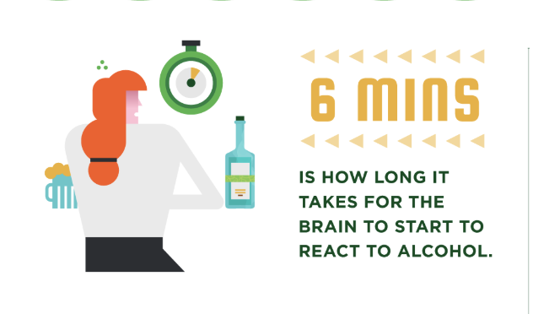

Slide 16
Methods
Regression: Y is quantitative (price, blood pressure, height)
Classification: Y takes values in a finite, unordered set (Survived / Died, 0-9, 1-5, pass/fail)

Slide 17
Our Plan
Look at classification: Logistic Regression
Learn about ggplot2 and its capabilities
Assess model accuracy and reiterate steps

Slide 18
Target Variable = G3 Grades
We can encode the pass/fail variable as a
0 - Fail
1 - Pass
Then we can regress Y on our Predictors and Classify Pass if…
Y > 0.5
For some values of X, linear regression might produce probabilities less than 0 or greater than 1.

Slide 19
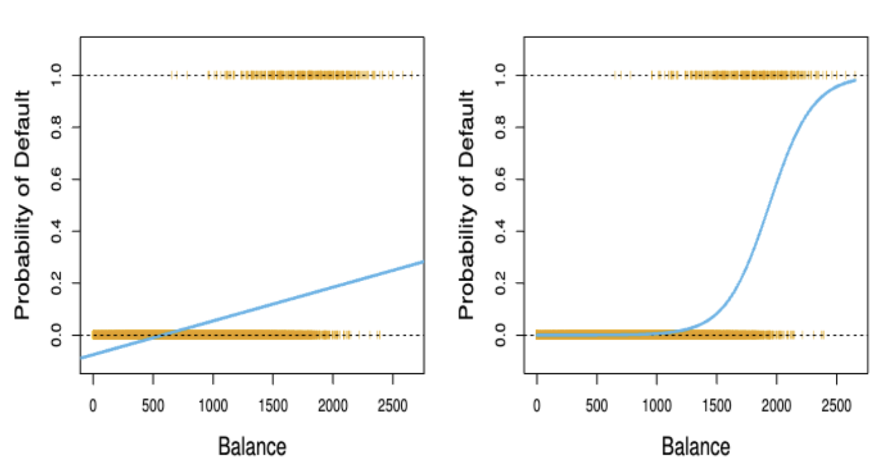
Enter Logistic Regression

Slide 20
Logistic Regressions model the probability that Y belongs to a particular category
In our case, logistic regression models the probability of failing
Pr(failing = yes | alcohol consumption)
So we make sure we get values between 0 and 1

Slide 21
Additional Resources
R-Documentation
https://www.rdocumentation.org/
R-Survey
https://www.jetbrains.com/lp/devecosystem-2020/r/

